Slide 1
How to Provision Windows Servers Using Terraform and Azure Pipelines
Mark Gossa
Infrastructure Engineering Lead, UK Banking

Slide 2
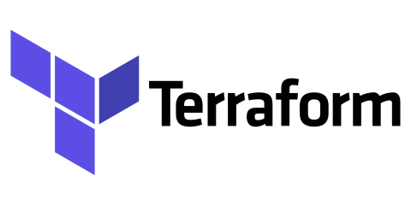
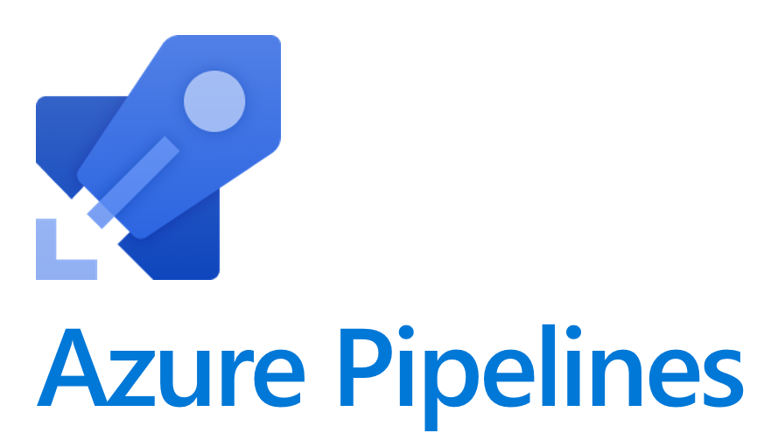
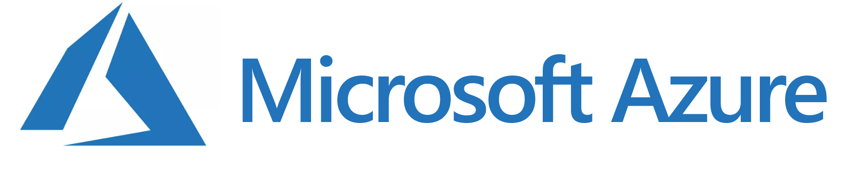
0 to Virtual Machine in 6mins

Slide 3
0 to Virtual Machine in under 10mins

Slide 4

About me
Mark Gossa
Infrastructure Engineering Lead
@markgossa
https://markgossa.blogspot.com
Github.com/markgossa
Notes:
All things DevOps
Infrastructure as code
Mostly serverless

Slide 5
Outline
What is Terraform?
Terraform basics
Azure Pipelines
Terraform with Azure Pipelines and Ansible

Slide 6
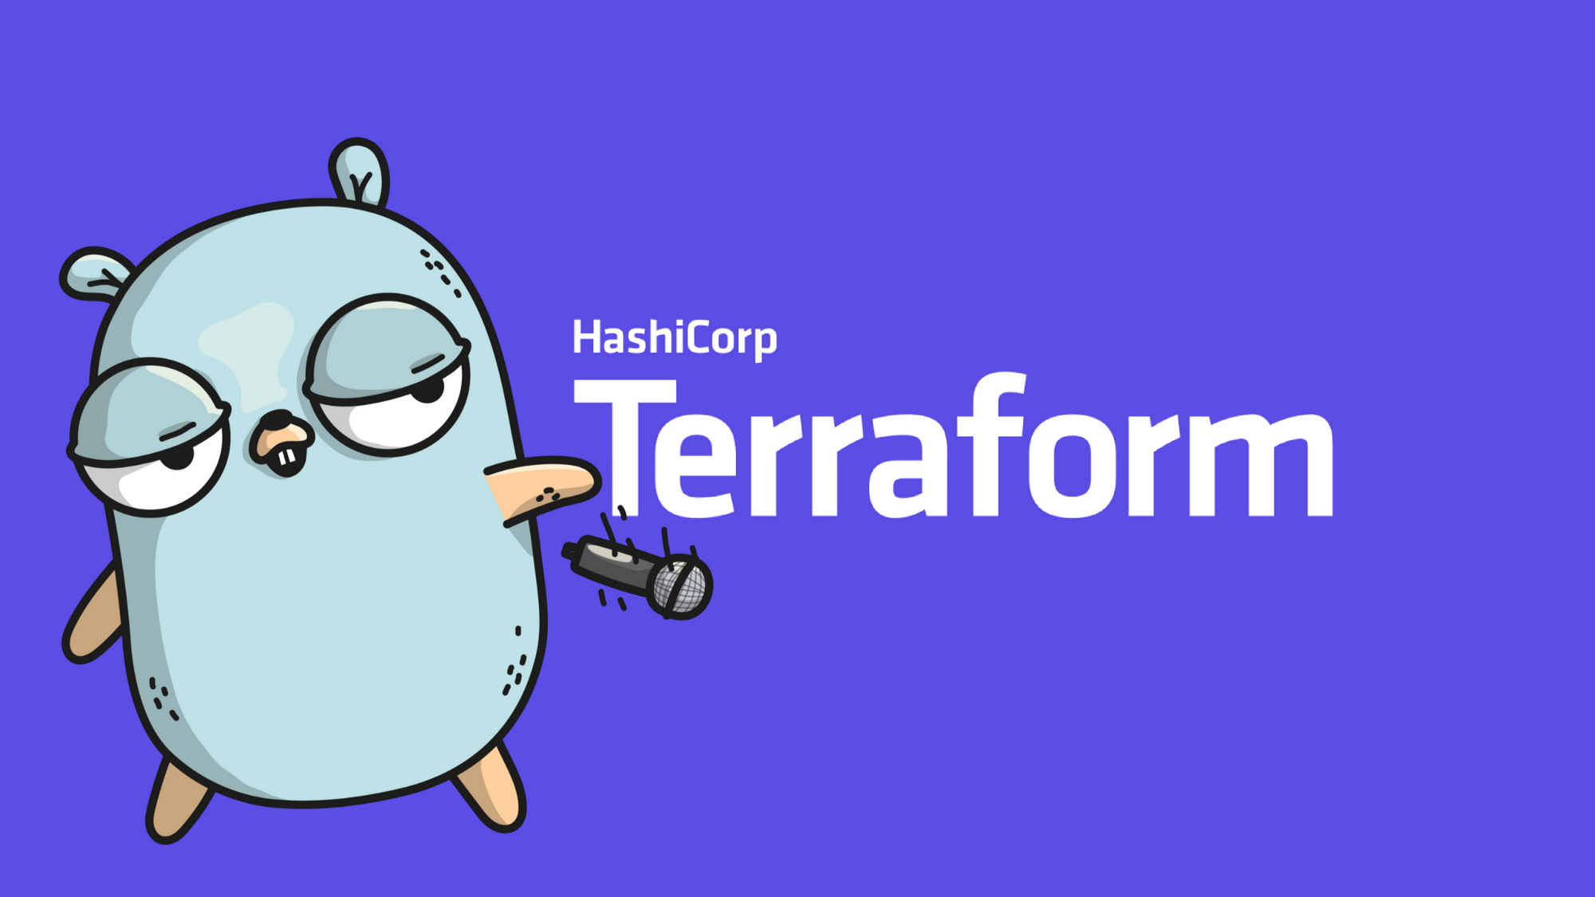
Terraform Basics
Infrastructure as Code
HCL
Multi-provider
Notes:
Infrastructure as Code – you basically write out code that defines what your infrastructure will look like
Cost reduction/speeds up deployment
Prevents snowflake servers/configuration drift
Idempotent
Repeatable
Self-documenting

Slide 7


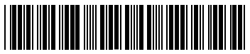
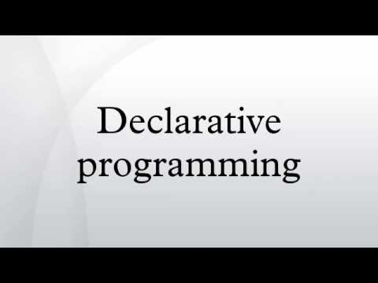




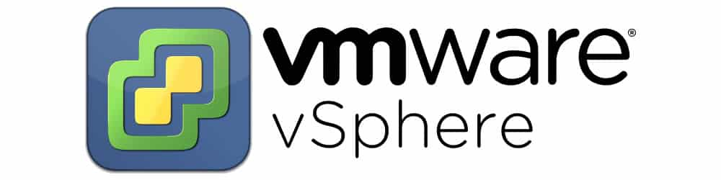
Why Terraform?
HCL
JSON
Notes:
Easy to read
No management server required, like Ansible, Chef, Puppet etc
Good online documentation. Open source/GitHub.
Terraform = declarative (like ARM templates, PowerShell DSC etc). PowerShell is imperative. Declarative = what the end should be like so just make it so. Imperative = all the steps to get from the current state to the end goal.
No installation needed for terraform
Multi-cloud: AWS, Azure, Google Cloud, VMware etc. Modules available for each vendor. Although you’re now learning another language (HCL), you can use it for all clouds.

Slide 8

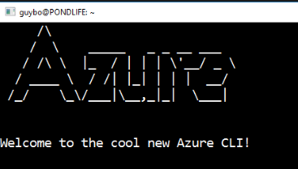


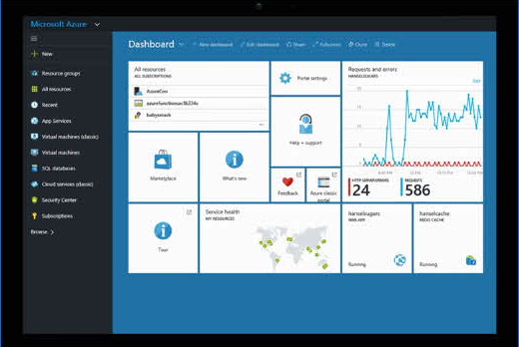
Other options
Azure REST API
ARM Templates
Notes:
There are many ways you can deploy Azure infrastructure
You want to move away from imperative tools and this includes PowerShell, REST API and .NET
I tried to make an Azure ‘DSC’ module
You want to move away from doing things manually so you get the benefits of infrastructure as code:
Faster deployment
Repeatibility
Source control/change tracking/auditability
Ability to deploy multiple identical environments
Self service
This leaves ARM templates as the main competitor

Slide 9
Terraform vs ARM templates
Property | Terraform | ARM Templates
Language | HCL | JSON
State file | Yes | No
Integration with Azure DevOps pipelines | Yes | Yes
Reusable modules | Yes | Yes
Multi-cloud | Yes | No
Plan output | Yes | No
Notes:
Language: Both have VSCode extension. With Terraform, you only need to learn HCL and you can use it with Azure, VMware, Google Cloud, AWS etc
ARM templates don’t keep a state file to improve deployment performance and keep track of metadata
Both have Azure DevOps integration and reusable modules. ARM templates use nested ARM templates.
ARM templates are just for Azure
Terraform can provide a plan of what it’ll do before it does it so you can check what it’s going to do

Slide 10
Terraform Commands
Command | Description
terraform init | Downloads terraform plugins/modules
terraform plan | Displays a list of actions that terraform will perform
terraform apply | Applies changes to infrastructure
terraform destroy | Destroys infrastructure that was created

Slide 11
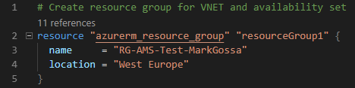
Terraform Resources

Slide 12
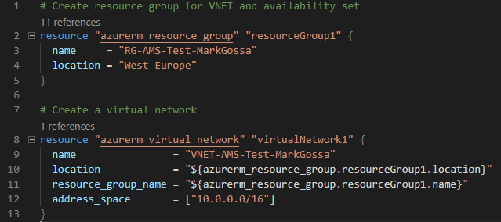
Terraform Dependencies
Terraform creates resources at the same time
Ensure that resources are created in order

Slide 13
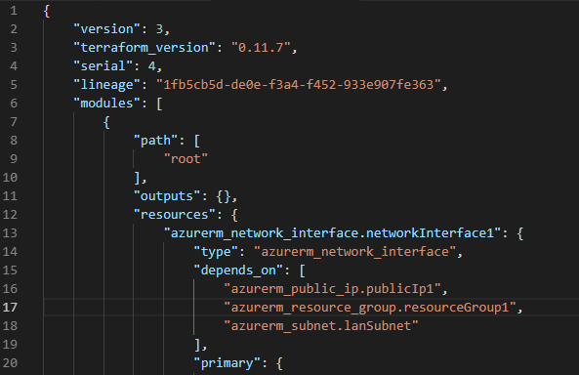
Terraform State File
Notes:
Don’t change what’s in here

Slide 14

Azure Pipelines
What you need:
Azure DevOps subscription
Azure subscription
Service principal
Build agent (hosted or private)
Notes:
Azure DevOps – you can sign up for free
Service principal - You need to pass a service principal to Terraform so that it can authenticate with Azure (client_id, client_secret, subscription_id, tenant_id)
Build agent – hosted included in your Azure DevOps subscription (including free subscription)

Slide 15
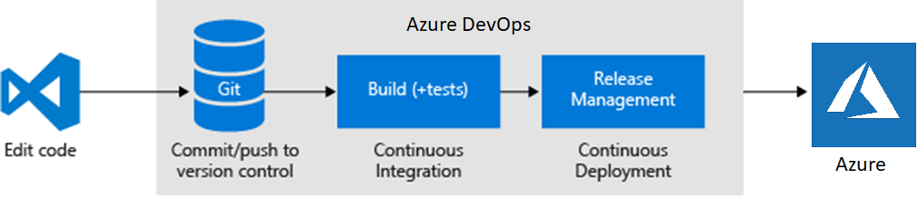
Azure Pipelines
Notes:
Edit code in VSCode, Visual Studio, notepad etc
Commit and push to source control. Doesn’t have to be Azure DevOps.
CI = build/compile the code and run unit tests
CD = deploy into environment and run integration tests

Slide 16
Azure Pipelines and Terraform
Install Terraform
Terraform init
Git clone Terraform Modules
Terraform validate
Publish code artefact
Publish terraform artefact
Notes:
Terraform validate = terraform checks the configuration is valid, including whether parameters are specified of the correct type etc
Other unit testing. You can look into other tools like kitchen-terraform and terratest.

Slide 17
Azure Pipelines and Terraform
Install Terraform
Terraform init
Git clone Terraform Modules
Terraform validate
Publish code artefact
Publish terraform artefact
Install Terraform
Terraform init
Terraform plan
Terraform apply
Deploy app code
Integration tests
Notes:
Terraform validate = terraform checks the configuration is valid, including whether parameters are specified of the correct type etc
Other unit testing. You can look into other tools like kitchen-terraform and terratest.

Slide 18
Demo
Notes:
Terraform configuration
Show there’s no WinOps RG
Start pipeline
Show multistage pipeline feature
Azure Pipeline as YAML configuration

Slide 19
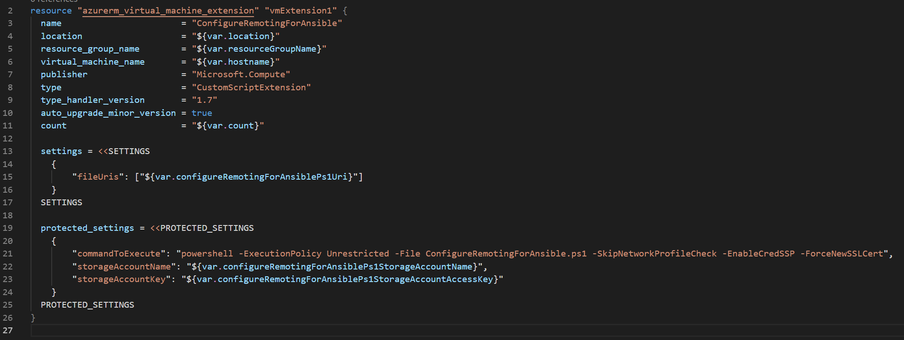
Ansible integration

Slide 20



Who’s using Terraform?

Slide 21
Summary
What is Terraform?
Terraform basics
Azure Pipelines
Terraform with Azure Pipelines and Ansible

Slide 22
“Great together!”

Slide 23

Thanks!
Mark Gossa
@markgossa
https://markgossa.blogspot.com
https://github.com/markgossa/AzureTalks

